Slide 1

Go, change the world
RV College of
Engineering
EMOTION DETECTION AND VOICE-EMOTION CONVERSIONS USING DEEP LEARNING
18EC64 : BE Minor Project -SEE Presentation
Presented by:
Anubha Mittal 1RV19EC024
P Harshita Gayathri 1RV19EC122
Vinitha V 1RV19EC198
Yeshitha B 1RV19EC199
Guide Name: Dr. Rajani Katiyar
Designation: Assistant Professor
Department of Electronics and Communication Engineering
*
Department of ECE
1

Slide 2


Go, change the world
CONTENT
RV College of
Engineering
Introduction
Motivation
Problem Statement
Objectives of the project
Literature Survey
Methodology
Project timeline
References
*
Department of ECE
2

Slide 3
Go, change the world
RV College of
Engineering
Introduction
Natural language processing[NLP] a theory-motivated range of computational techniques for the automatic analysis and representation of human language.
Emotion detection and recognition is a recent essential research area in Natural Language Processing (NLP) which may reveal some valuable input to a variety of purposes.
It can gauge how happy a population is, implores persuasive computing that enables us to give a consumer a personalized experience by better understanding his needs.
Semantic analysis has been widely used in NLP to understand language.
Emotions are not only important for human communications but also critical for human computer interactions.
*
Department of ECE
3

Slide 4
Go, change the world
RV College of
Engineering
Motivation
John Chambers, CEO of Cisco Systems, likes to listen to voice mails forwarded to him from dissatisfied customers. He says, “Email would be more efficient, but I want to hear the emotion, I want to hear the frustration, I want to hear the caller’s level of comfort with the strategy we’re employing. I can’t get that through e-mail.”
*
Department of ECE
4

Slide 5
Go, change the world
RV College of
Engineering
Motivation
Intrigued by the course Intelligent Systems, we got an insight into the various possibilities of machine learning. With the advancements in technology from keypad to touch to speech. SER represents the future.
Speech emotion recognition is employed in many fields like call center applications and mobile communication.
The few basic universal emotions include neutral, anger, happiness, sadness, fear, disgust, surprise and boredom.These emotions can be recognised using deep learning and machine learning models along with some computational features.
*
Department of ECE
5

Slide 6


Go, change the world
RV College of
Engineering
Problem Statement
The existing systems do not take into account the emotion of a user. This creates a gap between the customer expectation and service delivery.
“Develop a model for extracting acoustic emotions from speech using principles of Machine Learning and Deep Learning, with increased performance which helps in building an effective human-interaction machine based on user emotions.”
*
Department of ECE
6

Slide 7
Go, change the world
RV College of
Engineering
Objectives of the Project
To study the various features of speech and classify the emotions with the help of
ML and DL models
To use BERT model which could possibly improve accuracy and to implement Voice Conversions using GANs.
To implement Emotion Conversions using MelGANs.
*
Department of ECE
7

Slide 8
Go, change the world
RV College of
Engineering
Literature Survey
Sl No | Paper Title, Journal Name, Year | Major findings / observations
1 | P. Tzirakis, A. Nguyen, S. Zafeiriou and B. W. Schuller, "Speech Emotion Recognition Using Semantic Information," ICASSP 2021 - 2021 IEEE International Conference on Acoustics, Speech and Signal Processing (ICASSP), 2021, pp. 6279-6283, doi: 10.1109/ICASSP39728.2021.9414866 | The paper proposed a novel framework that can capture both the semantic and the paralinguistic information in the signal The semantic and paralinguistic features are combined to a unified representation using a novel attention mechanism, which is then passed through a LSTM to capture the temporal dynamics in the signal. The proposed model is evaluated on the SEWA dataset and produces state-of-the-art results on the valence and liking dimensions
2 | M. M. H. El Ayadi, M. S. Kamel, and F. Karray, “Speech Emotion Recognition using Gaussian Mixture Vector Autoregressive Models,” in 2007 IEEE International Conference on Acoustics, Speech and Signal Processing - ICASSP ’07, 2007, vol. 4, pp. IV–957–IV–960. | Proposed a Gaussian mixture vector autoregressive (GMVAR) approach. GMVAR is able to disseminate information in multiple modes and to design a dependency between speech feature sets With Berlin emotional dataset it gave the experimental result having classification accuracy is 76 percent when HMM is 71 percent, K-NN is 67 percent and FF-NN is 55%.
*
Department of ECE
8

Slide 9
Go, change the world
RV College of
Engineering
Sl No | Paper Title, Journal Name, Year | Major findings / observations
3 | Abdul Malik Badshah, Jamil Ahmad, Nasir Rahim, and Sung Wook Baik, “Speech emotion recognition from spectrograms with deep convolutional neural network,” in Platform Technology and Service (PlatCon), 2017 International Conference on. IEEE, 2017, pp. 1–5. | It proposed a CNN model consisting of three convolutional layer and three fully connected layer extract discriminative features from spectrogram images and outputs predictions for the seven emotion. Berlin dataset was used for training and testing. It also investigated the effectiveness of transfer learning for emotions recognition using a pre-trained AlexNet model Indicated that freshly trained model is better than fine tuned model.
4 | Zakaria Aldeneh and Emily Mower Provost, “Using regional saliency for speech emotion recognition,” in Acoustics, Speech and Signal Processing (ICASSP), 2017 IEEE International Conference on. IEEE, 2017, pp. 2741–2745. 6 | It proposed a novel multimodal dual recurrent encoder model. Using dual RNN the information from audio and text sequences are encoded. Then using Feed- forward neural model these information are combined to predict emotion class. The accuracy obtained by the proposed model ranges from 68.8% - 71.8% when evaluated for IEMOCAP dataset.
*
Department of ECE
9

Slide 10
Go, change the world
RV College of
Engineering
Sl No | Paper Title, Journal Name, Year | Major findings / observations
5 | Dario Bertero and Pascale Fung. “A first look into a convolutional neural network for speech emotion detection”. In: 2017 IEEE international conference on acoustics, speech and signal processing (ICASSP). IEEE. 2017, pp. 5115–5119 | Uses TED Talk speech audio dataset. Classifies 3 emotions Happy, Sad, and Angry using CNN. Results are lower for Happy emotion. Accuracy achieved - CNN 66.1%
6 | S. Kavitha, N. Sanjana, K. Yogajeeva and S. Sathyavathi, "Speech Emotion Recognition Using Different Activation Function," 2021 International Conference on Advancements in Electrical, Electronics, Communication, Computing and Automation (ICAECA), 2021, pp. 1-5, doi: 10.1109/ICAECA52838.2021.9675789.. | Gives an overview of effects of different activation functions on SER for a LSTM model. Shows that the disadvantages of RNN's vanishing gradient problem were overcome by LSTM. With the proposed LSTM recurrent network, the efficiency produced by the network using activation function relu(0.5883892464637756) was the highest.
*
Department of ECE
10

Slide 11
Go, change the world
RV College of
Engineering
Sl No | Paper Title, Journal Name, Year | Major findings / observations
7 | P. A. Babu, V. Siva Nagaraju and R. R. Vallabhuni, "Speech Emotion Recognition System With Librosa," 2021 10th IEEE International Conference on Communication Systems and Network Technologies (CSNT), 2021, pp. 421-424, doi: 10.1109/CSNT51715.2021.9509714. | This paper provides a simple and efficient model for speech emotion detection, evaluated on Ravedess dataset. Using MLP classifier due to its ability to handle highly volatile data having non-constant variance. Taking mfcc and chroma as input features for MLP classifier the efficiency obtained is 82.86%.
8 | M. Sakurai and T. Kosaka, "Emotion Recognition Combining Acoustic and Linguistic Features Based on Speech Recognition Results," 2021 IEEE 10th Global Conference on Consumer Electronics (GCCE), 2021, pp. 824-827, doi: 10.1109/GCCE53005.2021.9621810. | Proposed emotional speech recognition method that uses a combination of both acoustic model and language model adaptation. To extract linguistic features speech is converted into text by using high -accuracy ASR. eVectors features are used for extracting emotional features from text for emotion recognition. For emotion recognition by acoustic features, low-level-descriptor LLD are extracted and given as inputs for DNN layer. When both acoustic and linguistic features were used the performanced increased attaining an overall accuracy of 77.25%
*
Department of ECE
11

Slide 12
Go, change the world
RV College of
Engineering
Sl No | Paper Title, Journal Name, Year | Major findings / observations
9 | Kundan Kumar, Rithesh Kumar, T.de Boissiere, Lucas Gestin, W.Z.Teoh, J.Sotelo, Alexandre de Brebisson,Y.Bengio, Aaron Courville, “MelGAN:Generative Adversarial Networks for Conditional Waveform Synthesis”, NeurIPS, 2019 | Speech synthesis, Music domain translations and text-speech synthesis. Non-autoregressive feed-forward convolutional architecture. MelGAN is substantially faster than other mel-spectrogram inversion alternatives.
10 | Antreas Antoniou, Amos Storkey, and Harrison Edwards. “Data augmentation generative adversarial networks”. In: arXiv preprint arXiv:1711.04340 (2017). | Emotions classified based on face images. Design and train a generative model to do data augmentation. It can be applied to novel unseen classes of data. An overall of 13% increase in the performance of the model.
*
Department of ECE
12

Slide 13
Go, change the world
RV College of
Engineering
Design Methodology
Dataset
Three different Databases namely The Ryerson Audio-Visual Database of Emotional Speech and Song (RAVDESS), Toronto emotional speech set (TESS), and Surrey Audio-Visual Expressed Emotion (SAVEE). All the audio files are taken in .WAV file format.In total there are 4528 audio files all put together. All the datasets required are downloaded from the official websites of the universities. It is also available on kaggle.
*
Department of ECE
13

Slide 14
Go, change the world
RV College of
Engineering
RAVDESS :
Contains 24 professional actors (12 female, 12 male), speech emotions include calm, happy, sad, angry, fearful, surprise, and disgust expressions. There are 1440 audio files.
2) TESS:
Contains seven emotions: anger, disgust, fear, happiness, pleasant surprise, sadness, and neutral. There are 2800 data points (audio files 200) in total.
3) SAVEE:
Contains english male speakers (identified as DC, JE, JK, KL). Emotions are: anger,
disgust,fear, happiness, sadness and surprise. There are 480 audio files.
*
Department of ECE
14

Slide 15
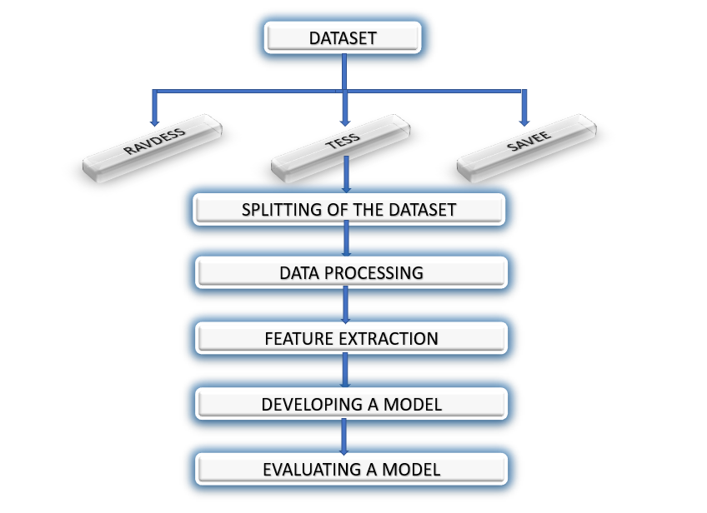
Go, change the world
RV College of
Engineering
Design Methodology
*
Department of ECE
15

Slide 16
Go, change the world
RV College of
Engineering
Details of Software / Hardware
The software being used for the project is Google Collab.
In future it may require GPU units for computational assistance to support complex algorithms and huge datasets.
*
Department of ECE
16

Slide 17
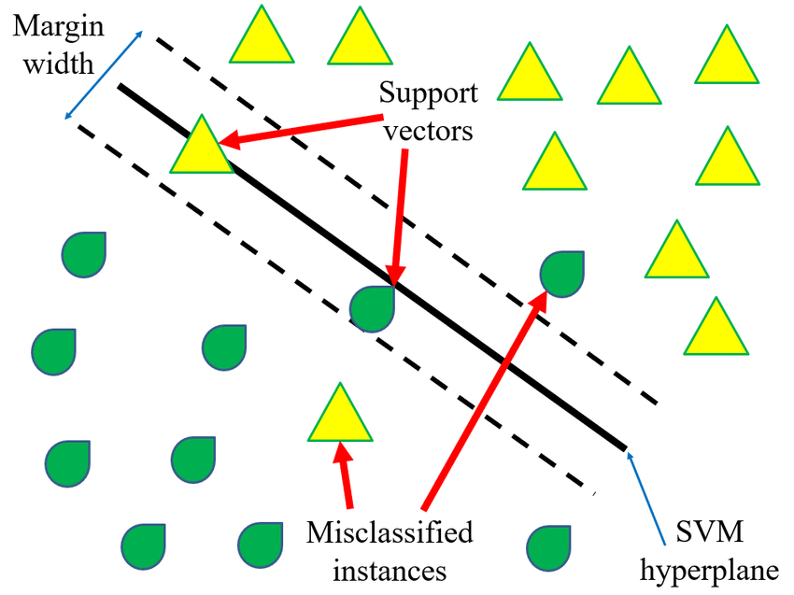
Go, change the world
RV College of
Engineering
SUPPORT VECTOR MACHINE
SVM algorithm is to create the best line or decision boundary that can segregate n-dimensional space into classes so that we can easily put the new data point in the correct category in the future. This best decision boundary is called a hyperplane.
*
Department of ECE
17

Slide 18
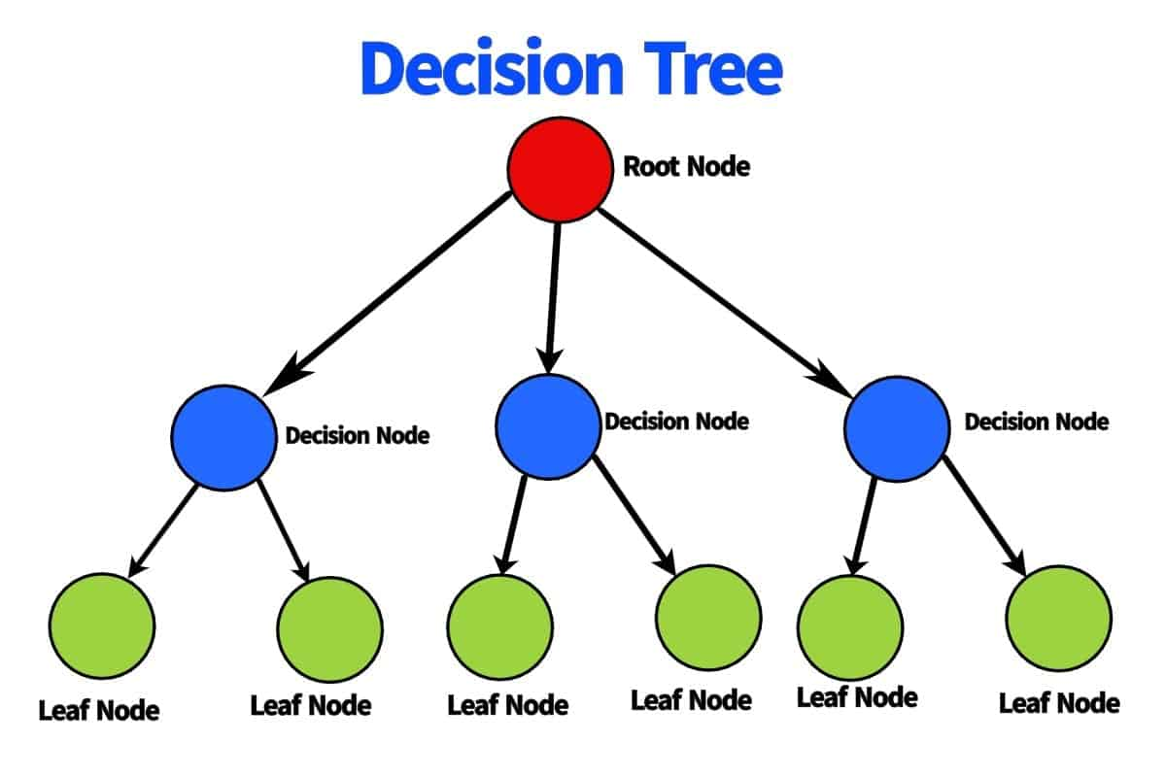
Go, change the world
RV College of
Engineering
DECISION TREE
A graphical representation for getting all the possible solutions to a problem/decision based on given conditions. The ID3 algorithm was used to classify the data.
*
Department of ECE
18

Slide 19
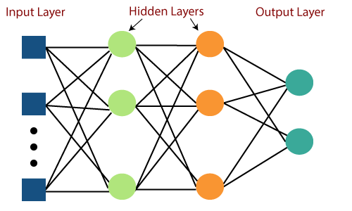
Go, change the world
RV College of
Engineering
MULTI-LAYERED PERCEPTRON
A Multilayer Perceptron has input and output layers, and one or more hidden layers with many neurons stacked together.
*
Department of ECE
19

Slide 20
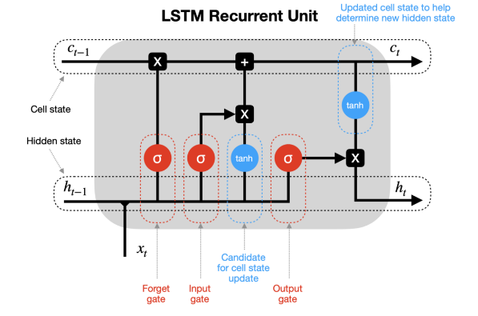
Go, change the world
RV College of
Engineering
LONG SHORT TERM MEMORY
LSTM has a chain structure that contains four neural networks and different memory blocks called cells. Information is retained by the cells and the memory manipulations are done by the gates
*
Department of ECE
20

Slide 21

Go, change the world
RV College of
Engineering
CONVOLUTIONAL NEURAL NETWORK
Convolutional neural networks are composed of multiple layers of artificial neurons.
*
Department of ECE
21

Slide 22
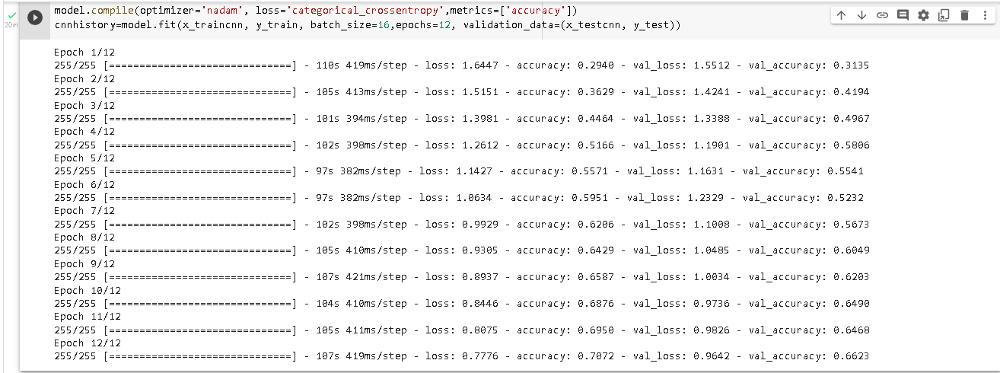
OUTPUT

Slide 23
COMPARISON BETWEEN DIFFERENT MODELS
MODEL | TRAINING ACCURACY | TESTING ACCURACY
Support Vector Machine (SVM) | 15.78% | 13.79%
Decision Tree (DT) | 46.44% | 44.26%
Multilayer Perceptron (MLP) | 19.19% | 16.28%
Long Short-Term Memory (LSTM) | 16.34% | 12.9%
Convolutional Neural Networks (CNN) | 69.45% | 67%

Slide 24
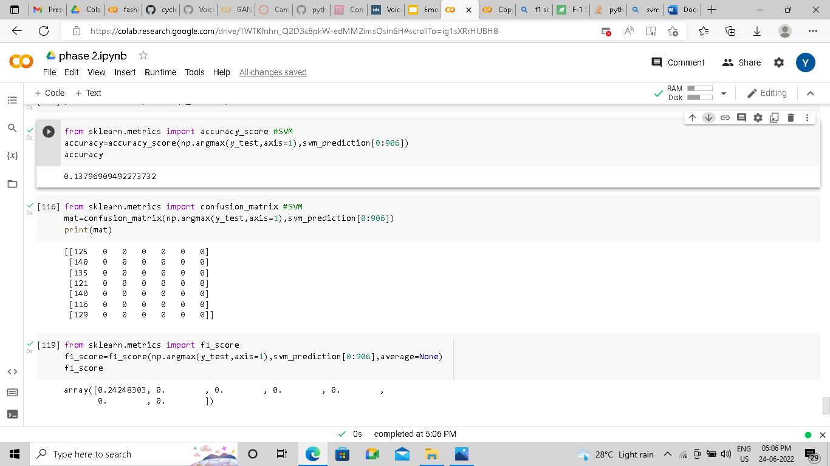
Go, change the world
RV College of
Engineering
CONFUSION MATRIX AND F1-SCORES
SVM
*
Department of ECE
24

Slide 25
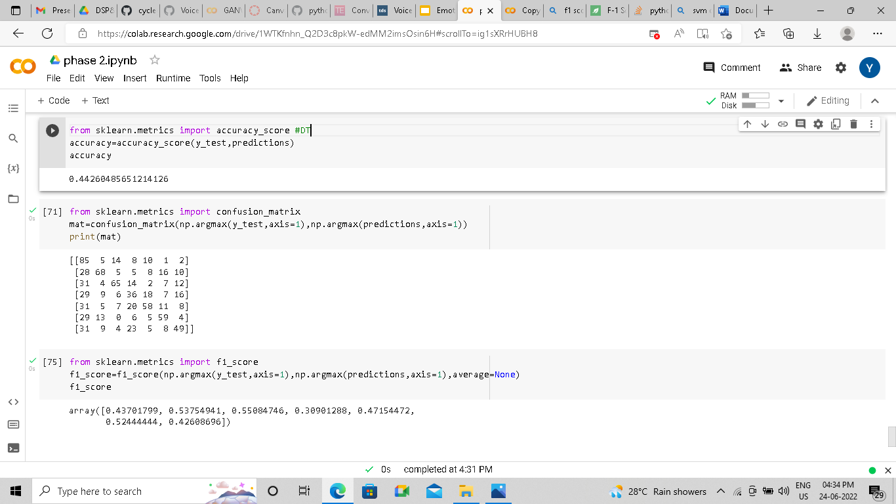
Go, change the world
RV College of
Engineering
2) DECISION TREE
*
Department of ECE
25

Slide 26
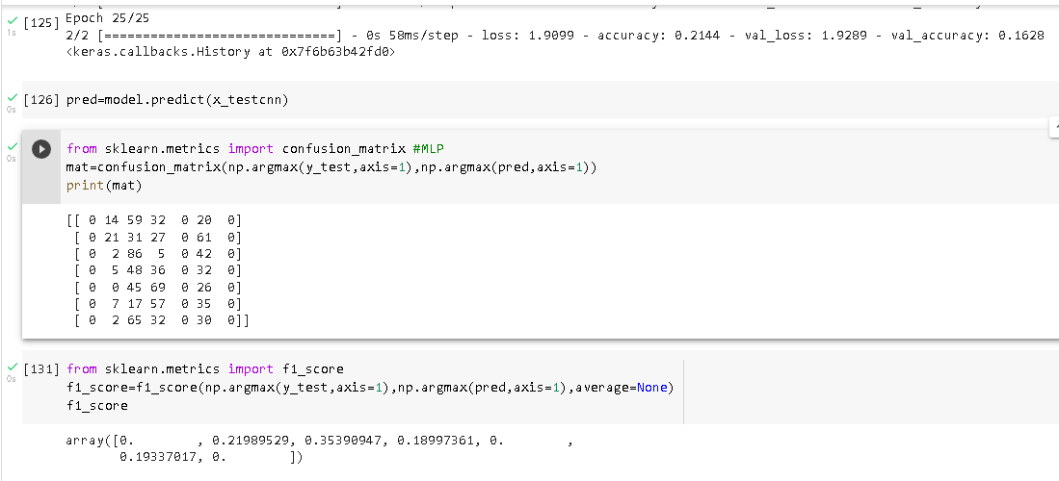
Go, change the world
RV College of
Engineering
3) MULTILAYER PERCEPTRON
*
Department of ECE
26

Slide 27
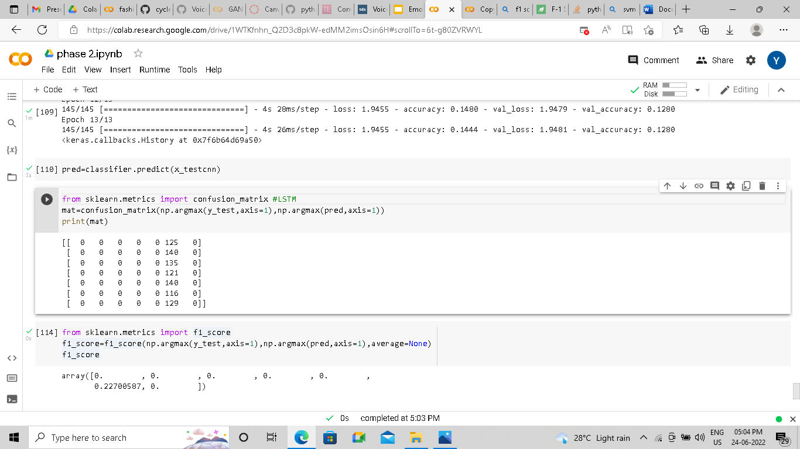
Go, change the world
RV College of
Engineering
4) LONG SHORT TERM MEMORY
*
Department of ECE
27

Slide 28
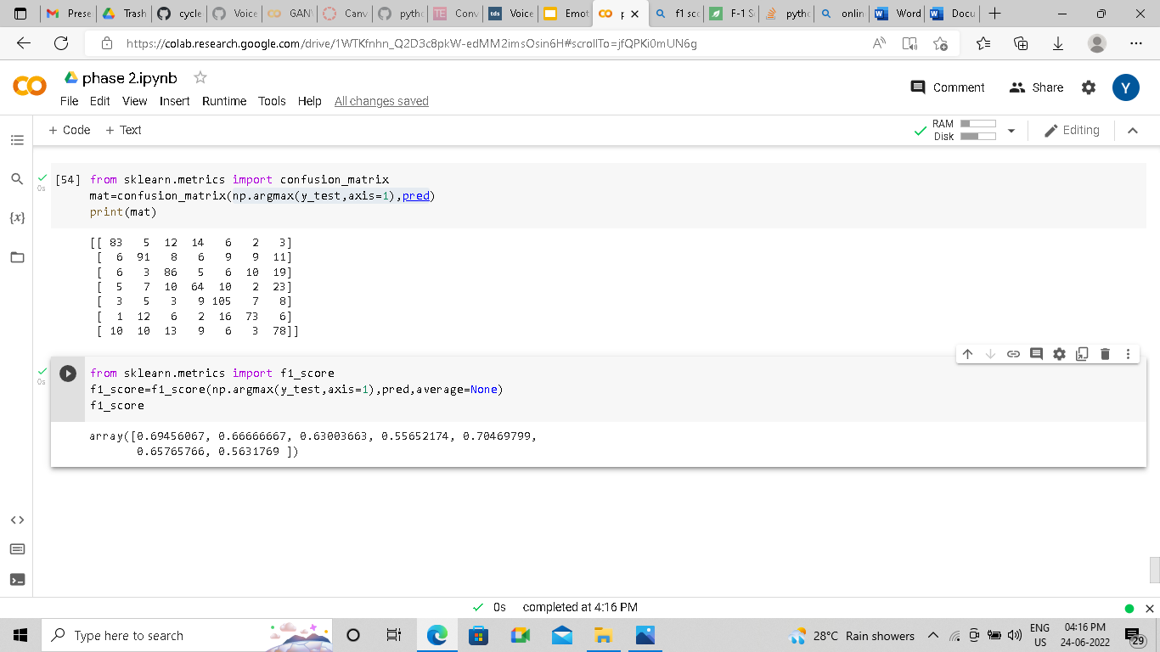
Go, change the world
RV College of
Engineering
5) CONVOLUTIONAL NEURAL NETWORK
*
Department of ECE
28

Slide 29
Go, change the world
EPOCH ANALYSIS
RV College of
Engineering
NO. OF EPOCHS | MLP | LSTM | CNN
5 | 9.08% | 8.32% | 32.41%
10 | 11.23% | 10.65% | 40.04%
15 | 14.56% | 12.58% | 48.78%
20 | 12.34% | 13.33% | 59.97%
25 | 16.28% | 12.9% | 67%
*
Department of ECE
29

Slide 30
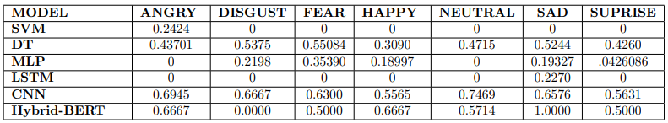
Go, change the world
F1 SCORE
RV College of
Engineering
*
Department of ECE
30

Slide 31
Go, change the world
RV College of
Engineering
BERT MODEL
In 2018, Google published a paper titled “Pre-training of deep bidirectional transformers for language understanding”. In this paper, they introduced a language model called BERT (Bidirectional Encoder Representation with Transformers) that achieved state-of-the-art performance in NLP tasks.
To put it in simple words BERT extracts patterns or representations from the data or word embeddings by passing it through an encoder.
The encoder itself is a transformer architecture for extracting temporal features via the self-attention process.
It is a bidirectional transformer which means that during training it considers the context from both left and right of the vocabulary to extract patterns or representations.
*
Department of ECE
31

Slide 32
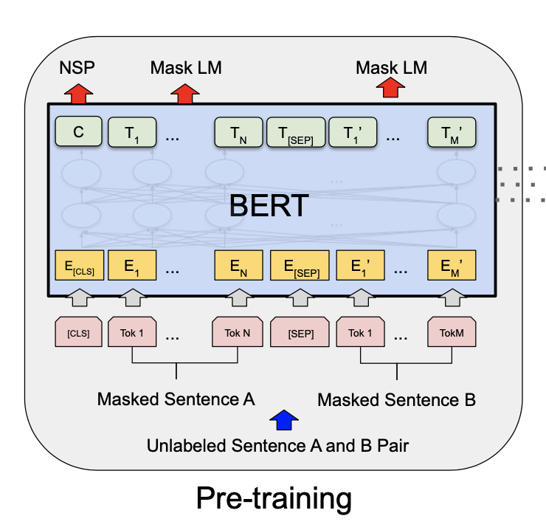
Go, change the world
RV College of
Engineering
BERT MODEL
BERT uses two training paradigms: Pre-training and Fine-tuning.
During pre-training, the model is trained on a large dataset to extract patterns. This is generally an unsupervised learning task where the model is trained on an unlabelled dataset like the data from a big corpus like Wikipedia.
*
Department of ECE
32

Slide 33
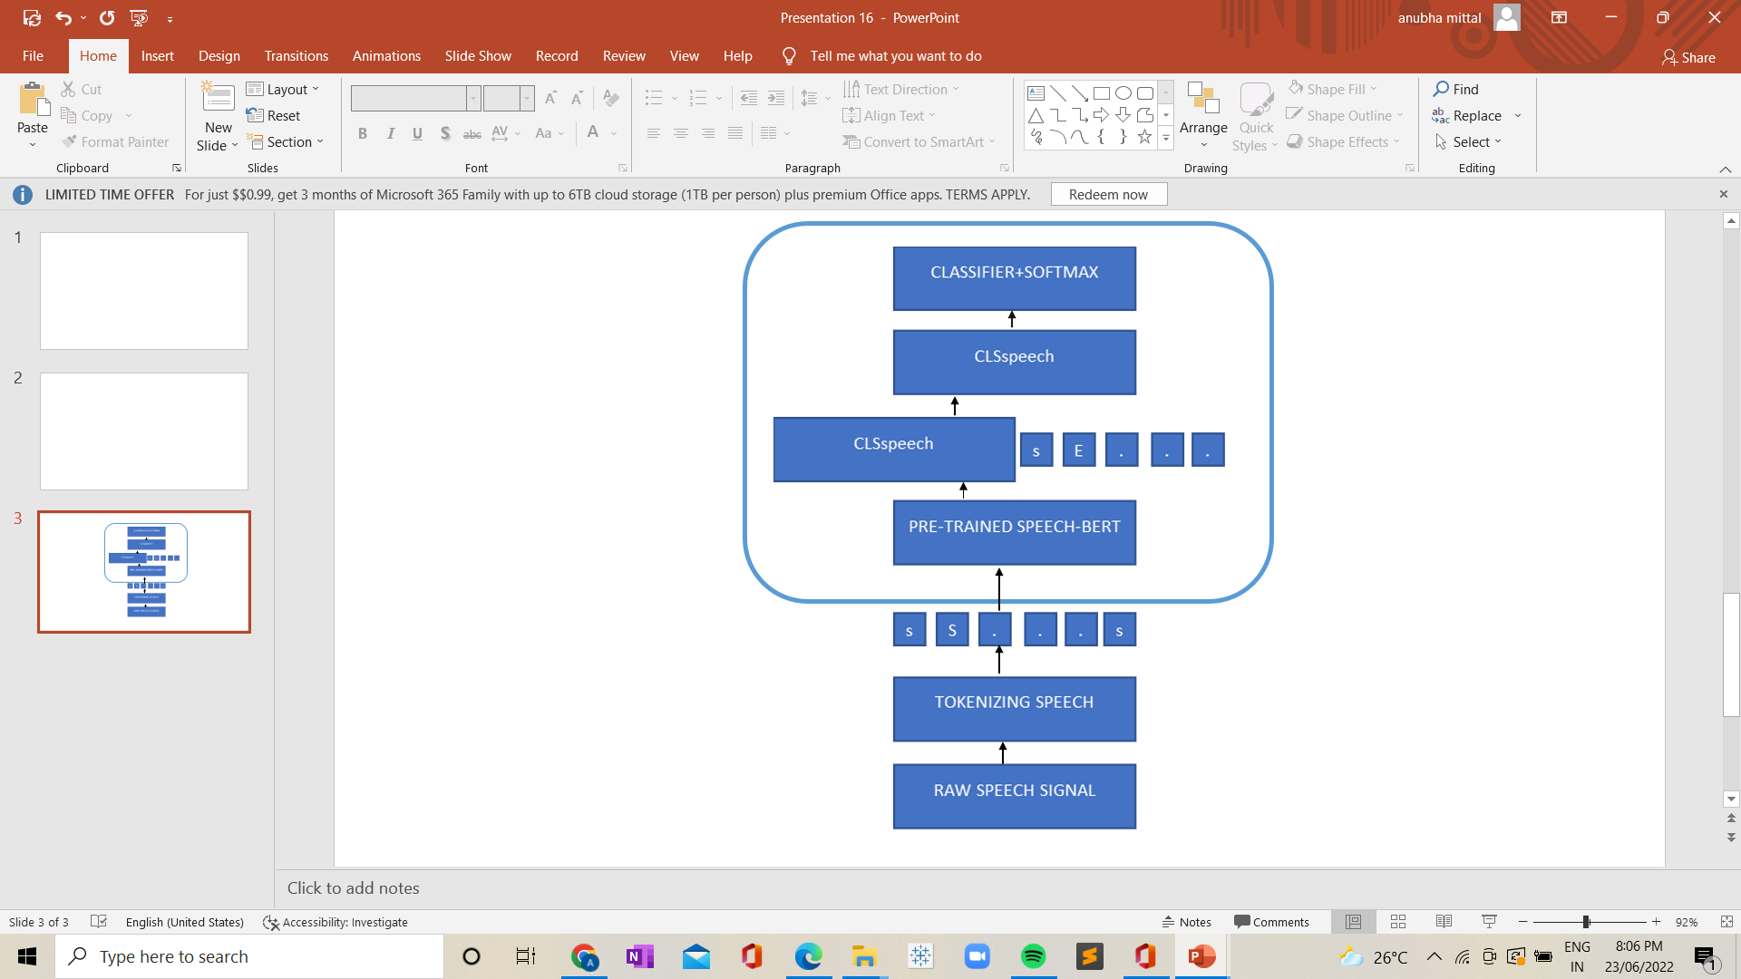
Go, change the world
RV College of
Engineering
BERT MODEL IN OUR PROJECT
*
Department of ECE
33

Slide 34
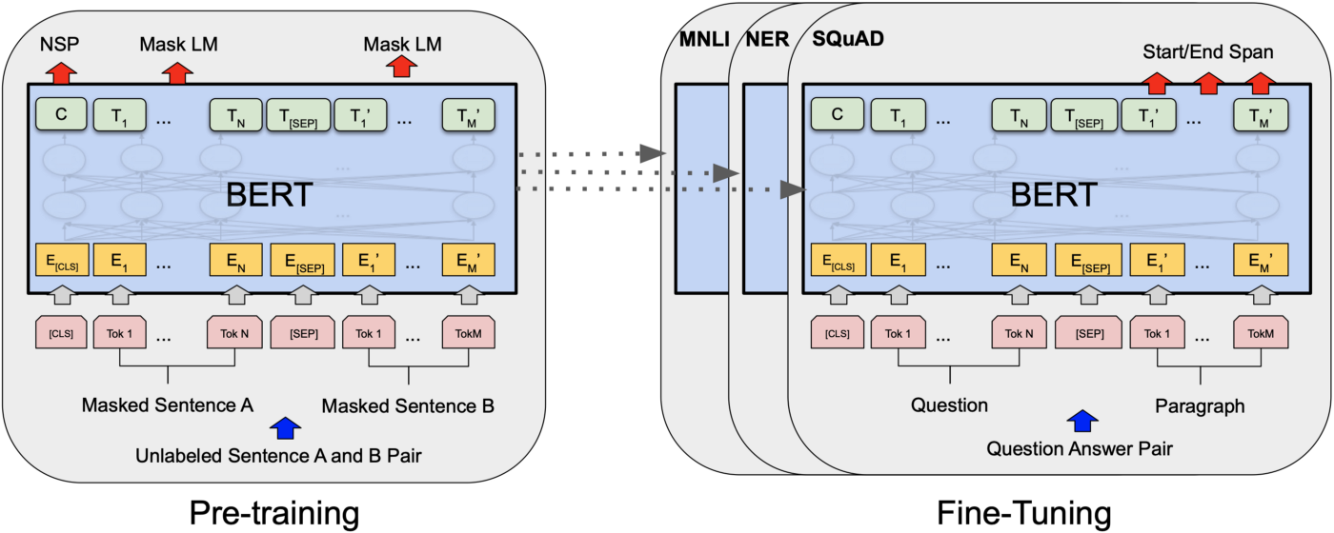
Go, change the world
RV College of
Engineering
BERT- WORKING
During fine-tuning the model is trained for downstream tasks like Classification, Text-Generation, Language Translation, Question -Answering, and so forth. Essentially, you can download a pre-trained model and then Transfer-learn the model on your data.
Essentially a BERT pretrained on acoustic data, and proceed to fine-tuning for the emotion classification task
*
Department of ECE
34

Slide 35
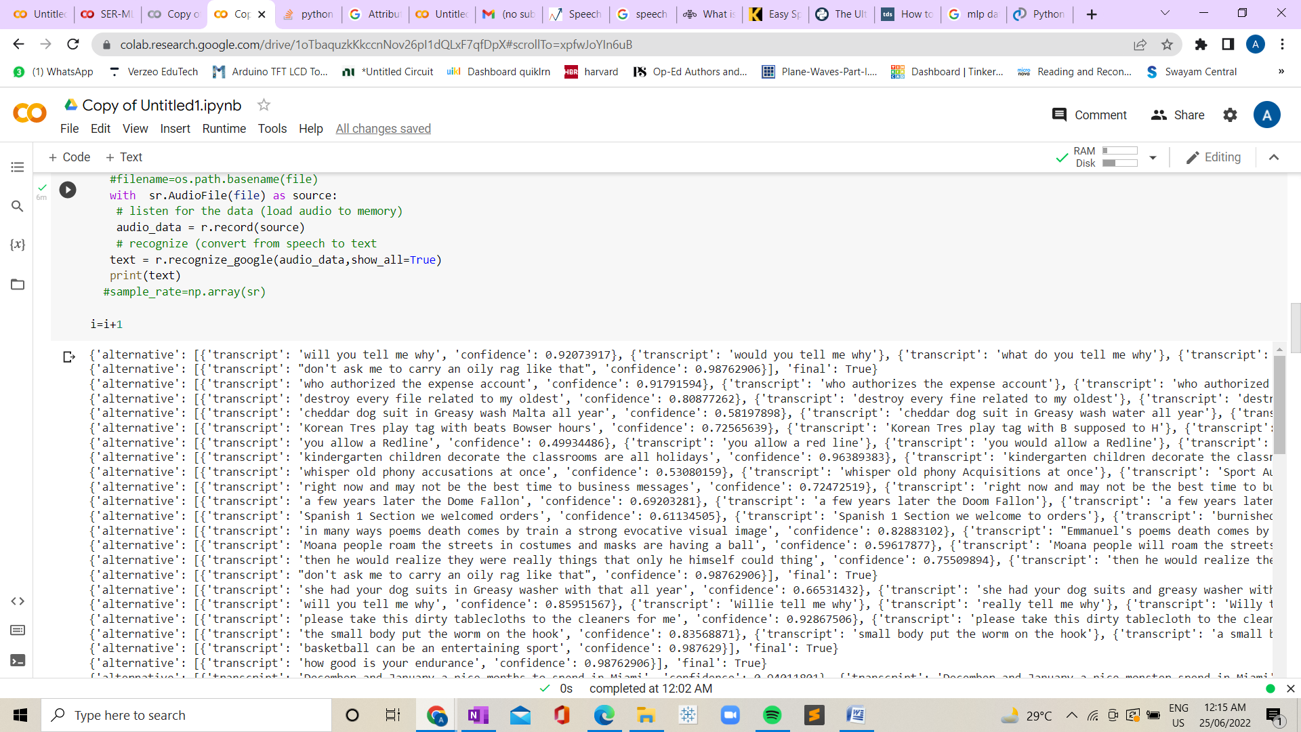
Go, change the world
RV College of
Engineering
TEXT CLASSIFICATION OUTPUT
*
Department of ECE
35

Slide 36
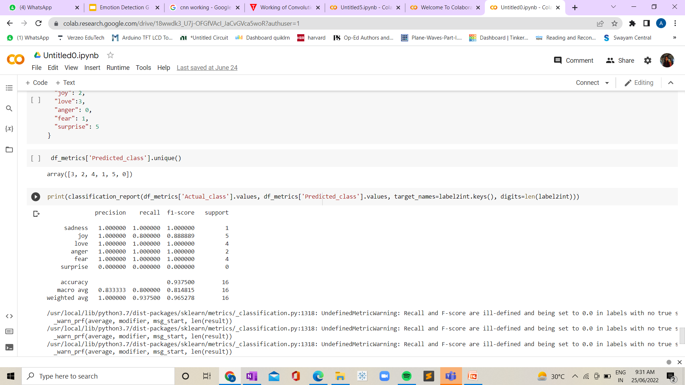
Go, change the world
RV College of
Engineering
TEXT CLASSIFICATION OUTPUT
*
Department of ECE
36

Slide 37
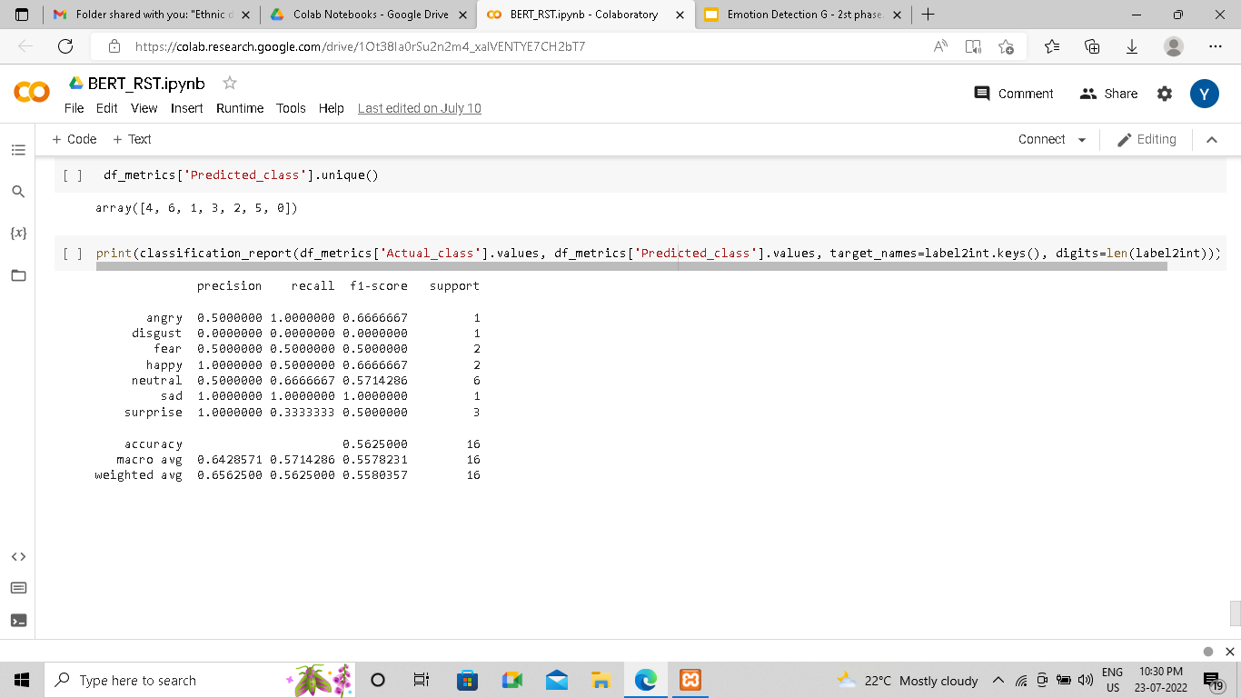
Go, change the world
RV College of
Engineering
HYBRID OUTPUT
*
Department of ECE
37

Slide 38
Go, change the world
RV College of
Engineering
GENERATIVE ADVERSARIAL NETWORKS
Generative Adversarial Network (GANs) are neural networks used for unsupervised learning.
It is made up of a system of two competing neural network models namely the Generator and Discriminator which compete with each other and are able to analyze, capture and copy the variations within a dataset.
This technique learns to generate new data
The input to the generator is given as a random noise vector
The input to the discriminator consists of real datasets and the fake data generated by the generator.
*
Department of ECE
38

Slide 39
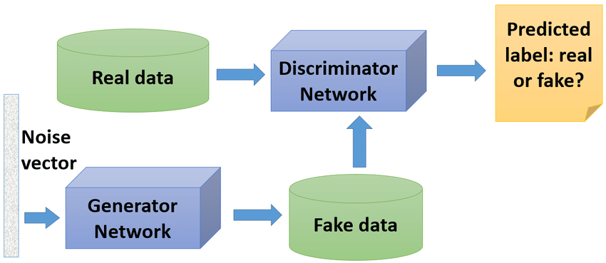
Go, change the world
RV College of
Engineering
Generator : The Generator generates fake samples of data and tries to fool the Discriminator. It tries to maximize the probability of the Discriminator in making a mistake by fooling.
Discriminator : Tries to distinguish between the real and fake samples. that estimates the probability that the sample that it got is received from the training data and not from the Generator.
When the discriminator successfully identifies real and fake samples, it is rewarded, whereas the generator is penalized with large updates to model parameters and visa versa when generator is penalized
*
Department of ECE
39

Slide 40
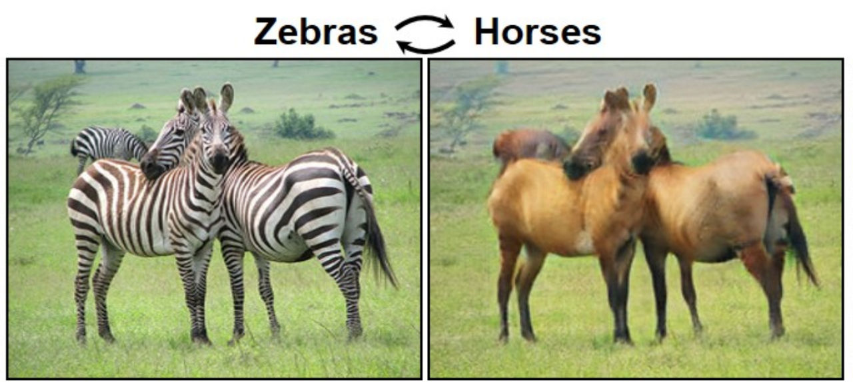
Go, change the world
RV College of
Engineering
WHY GANs?
GANs work well with unseen dataset as well.
It is more immune to noises
present as the generator is
trained with random noise
vector making discriminator
effective in distinguishing.
In a scenario when there’s no
ample data for a problem you
are working on, in that case,
you can use adversarial
networks to generate more data.
Department of ECE
40

Slide 41
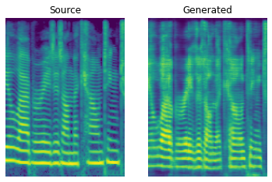
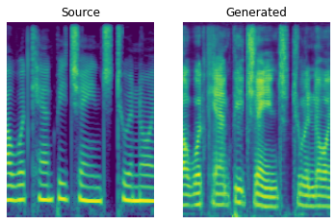

Go, change the world
RV College of
Engineering
VOICE CONVERSION OUTPUT ( F TO M )
EPOCH 1 EPOCH 10
*
Department of ECE
41

Slide 42
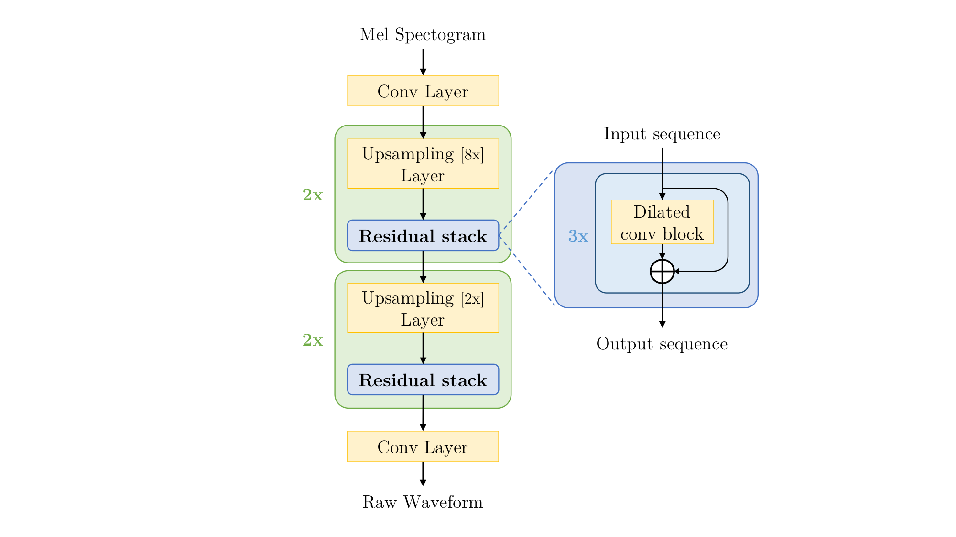
Go, change the world
RV College of
Engineering
MelGAN
The generator is a fully convolutional feed-forward network with mel-spectrogram as input and raw waveform as output.
This generator does not use a global noise vector as input. Instead an audio which needs to be converted to other emotion is used as the noise vector (here it is neutral).
*
Department of ECE
42

Slide 43
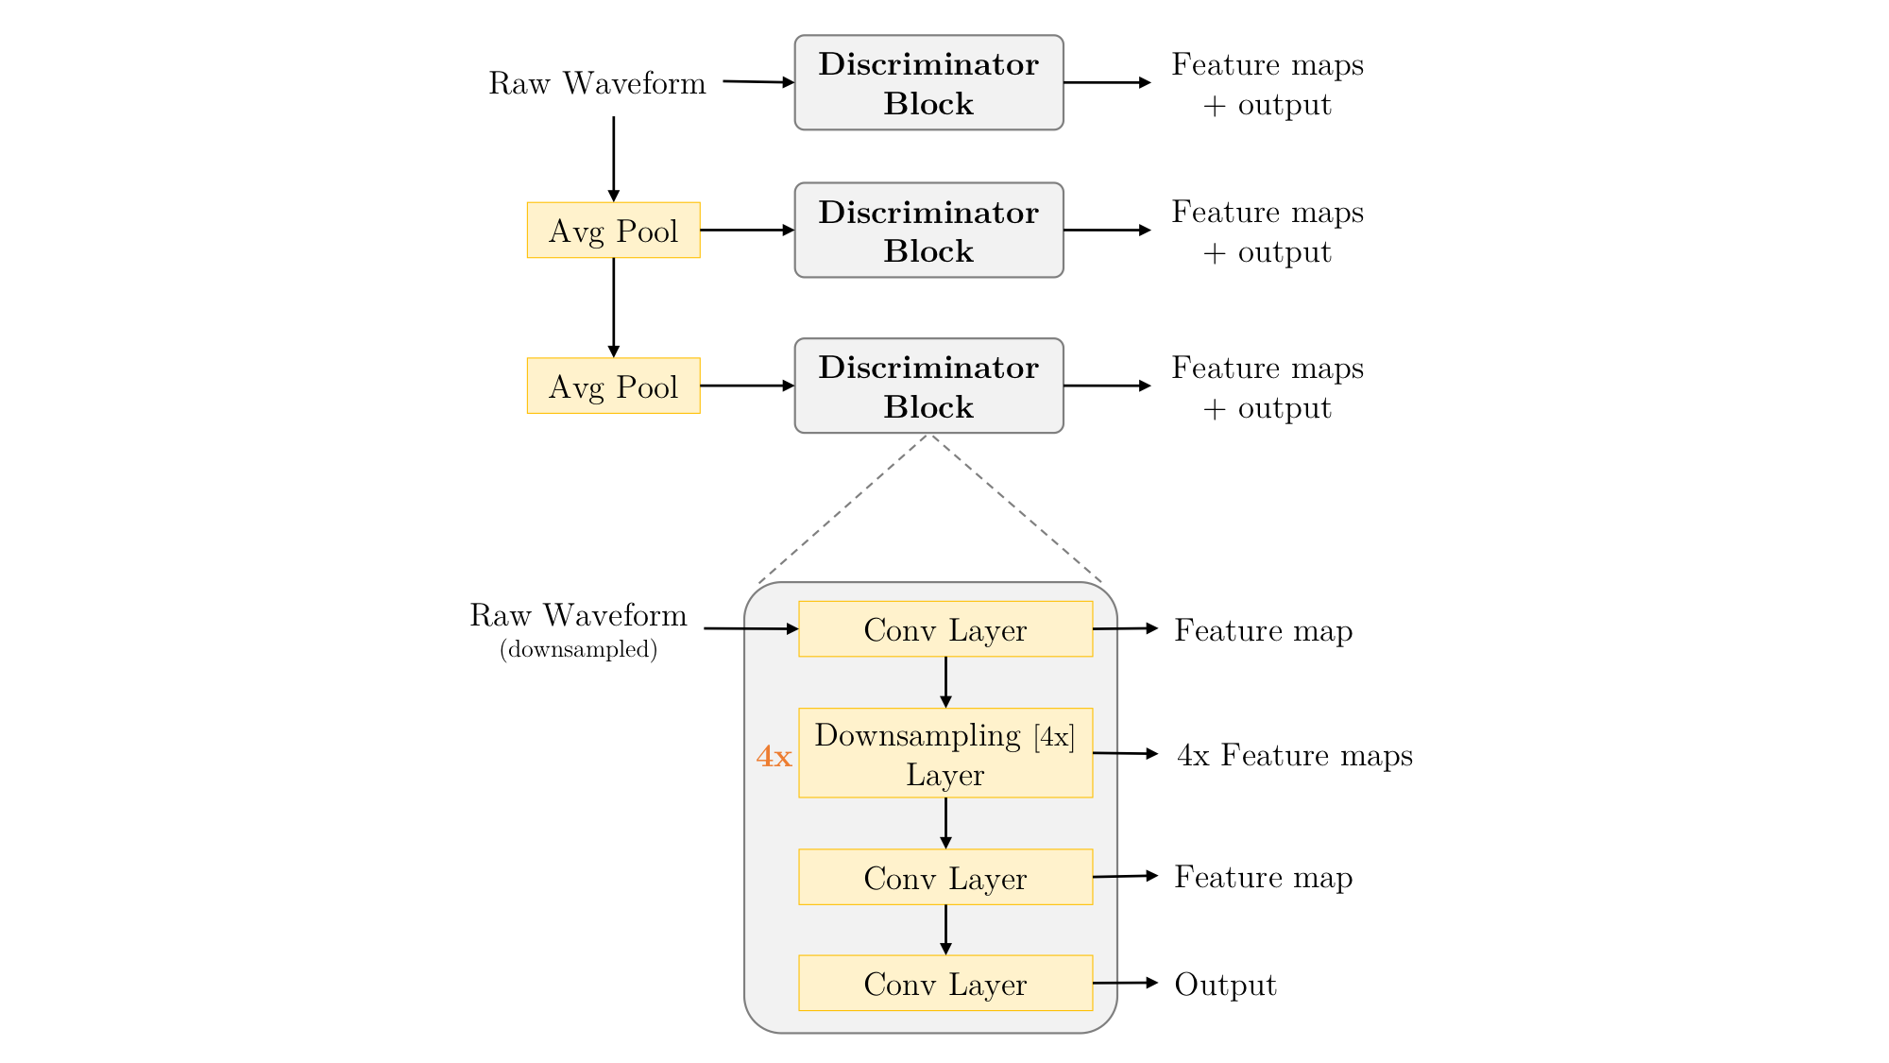
Go, change the world
RV College of
Engineering
MelGAN
The input to the discriminator is the audio datasets to which the noise vector is supposed to be converted (here it is happy,sad).
Spectrogram Inversions
MelGAN solves hardware constraint
*
Department of ECE
43

Slide 44
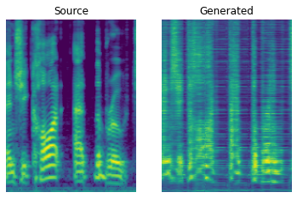
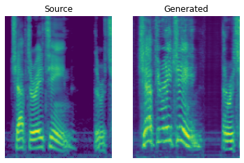
Go, change the world
RV College of
Engineering
MelGAN OUTPUT FOR HAPPY-M
EPOCH 1 EPOCH 50
*
Department of ECE
44

Slide 45
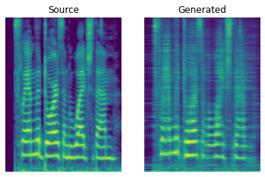
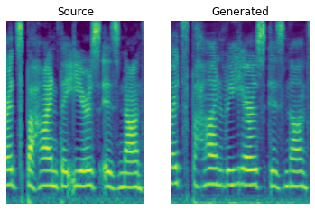
Go, change the world
RV College of
Engineering
MelGAN OUTPUT FOR SAD-F
EPOCH 1
EPOCH 1
EPOCH 1
EPOCH 1
EPOCH 50
*
Department of ECE
45

Slide 46
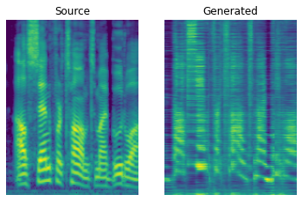
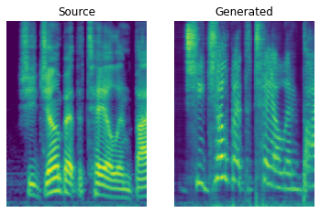
Go, change the world
RV College of
Engineering
MelGAN OUTPUT FOR ANGRY- FM
EPOCH 1
EPOCH 1
EPOCH 1
EPOCH 1
EPOCH 50
*
Department of ECE
46

Slide 47
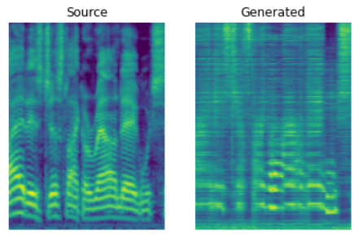
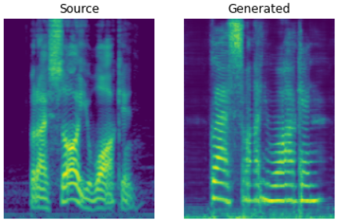
Go, change the world
RV College of
Engineering
MelGAN OUTPUT FOR SAD-FM
EPOCH 1
EPOCH 1
EPOCH 1
EPOCH 1
EPOCH 50
*
Department of ECE
47

Slide 48

Go, change the world
Timeline of the Project
RV College of
Engineering
 | April 2022 |  |  |  | May 2022 |  |  |  | June 2022
 | Week 01 | Week 02 | Week 03 | Week 04 | Week 01 | Week 02 | Week 03 | Week 04 | Week 01 | Week 02 | Week 03 | Week 04
Literature Survey
Specifications study
Architecture study & building basic SER Model
Tuning of parameters
Novelty
Implementation
Final Prototype
Documentation
18/04/22
30/04/22
12/0 5/22
23/0 5/2022
05/06/2022
10/06/2022
25/07/2022
30/07/2022
*
Department of ECE
Milestones
48

Slide 49
Go, change the world
RV College of
Engineering
References
Sl No | Author, Title of paper, Journal | Year
1 | P. Tzirakis, A. Nguyen, S. Zafeiriou and B. W. Schuller, "Speech Emotion Recognition Using Semantic Information," ICASSP 2021 - 2021 IEEE International Conference on Acoustics, Speech and Signal Processing (ICASSP), 2021, pp. 6279-6283, doi: 10.1109/ICASSP39728.2021.9414866 | 2021
2 | Enrique M Albornoz, Diego H Milone, and Hugo L Rufiner. “Spoken emotion recognition using hierarchical classifiers”. In: Computer Speech & Language 25.3 (2011), pp. 556–570. | 2011
3 | Zakaria Aldeneh and Emily Mower Provost. “Using regional saliency for speech emotion recognition”. In: 2017 IEEE international conference on acoustics, speech and signal processing (ICASSP). IEEE. 2017, pp. 2741–2745. | 2017
4 | Antreas Antoniou, Amos Storkey, and Harrison Edwards. “Data augmentation generative adversarial networks”. In: arXiv preprint arXiv:1711.04340 (2017). | 2017
*
Department of ECE
49

Slide 50
Go, change the world
RV College of
Engineering
References
Sl No | Author, Title of paper, Journal | Year
5 | P Ashok Babu, V Siva Nagaraju, and Rajeev Ratna Vallabhuni. “Speech Emotion Recognition System With Librosa”. In: 2021 10th IEEE International Conference on Communication Systems and Network Technologies (CSNT). IEEE. 2021, pp. 421–424. | 2021
6 | Abdul Malik Badshah et al. “Speech emotion recognition from spectrograms with deep convolutional neural network”. In: 2017 international conference on platform technology and service (PlatCon). IEEE. 2017, pp. 1–5. | 2017
7 | Dario Bertero and Pascale Fung. “A first look into a convolutional neural network for speech emotion detection”. In: 2017 IEEE international conference on acoustics, speech and signal processing (ICASSP). IEEE. 2017, pp. 5115–5119. | 2017
8. | Moataz MH El Ayadi, Mohamed S Kamel, and Fakhri Karray. “Speech emotion recognition using Gaussian mixture vector autoregressive models”. In: 2007 IEEE International Conference on Acoustics, Speech and Signal Processing-ICASSP’07. Vol. 4. IEEE. 2007, pp. IV–957. | 2007
*
Department of ECE
50

Slide 51
Go, change the world
RV College of
Engineering
References
Sl No | Author, Title of paper, Journal | Year
9 | John Gideon et al. “Progressive neural networks for transfer learning in emotion recognition”. In: arXiv preprint arXiv:1706.03256 (2017). | 2017
10 | Ian Goodfellow et al. “Generative adversarial nets”. In: Advances in neural information processing systems 27 (2014). | 2014
11 | Kun Han, Dong Yu, and Ivan Tashev. “Speech emotion recognition using deep neural network and extreme learning machine”. In: Interspeech 2014. | 2014
12. | S Kavitha et al. “Speech Emotion Recognition Using Different Activation Function”. In: 2021 International Conference on Advancements in Electrical, Electronics, Communication, Computing and Automation (ICAECA). IEEE. 2021, pp. 1– 5. | 2021
13. | Ruhul Amin Khalil et al. “Speech Emotion Recognition Using Deep Learning Techniques: A Review”. In: IEEE Access 7 (2019), pp. 117327–117345. doi: 10.1109/ ACCESS.2019.2936124. | 2019
*
Department of ECE
51

Slide 52
Go, change the world
RV College of
Engineering
References
Sl No | Author, Title of paper, Journal | Year
14. | Giovanni Mariani et al. “Bagan: Data augmentation with balancing gan”. In: arXiv preprint arXiv:1803.09655 (2018). | 2018
15. | Tin Lay Nwe, Say Wei Foo, and Liyanage C De Silva. “Speech emotion recognition using hidden Markov models”. In: Speech communication 41.4 (2003), pp. 603–623. | 2003
16. | M Parimala et al. “Spatiotemporal-based sentiment analysis on tweets for risk assessment of event using deep learning approach”. In: Software: Practice and Experience 51.3 (2021), pp. 550–570 | 2021
17. | Alec Radford, Luke Metz, and Soumith Chintala. “Unsupervised representation learning with deep convolutional generative adversarial networks”. In: arXiv preprint arXiv:1511.06434 (2015). | 2015
18. | Anisha P Rodrigues et al. “Real-time twitter spam detection and sentiment analysis using machine learning and deep learning techniques”. In: Computational Intelligence and Neuroscience 2022 (2022). | 2022
*
Department of ECE
52

Slide 53
Go, change the world
RV College of
Engineering
References
Sl No | Author, Title of paper, Journal | Year
19. | Saurabh Sahu, Rahul Gupta, and Carol Espy-Wilson. “On enhancing speech emotion recognition using generative adversarial networks”. In: arXiv preprint arXiv:1806.06626 (2018). | 2018
20. | Misaki Sakurai and Tetsuo Kosaka. “Emotion Recognition Combining Acoustic and Linguistic Features Based on Speech Recognition Results”. In: 2021 IEEE 10th Global Conference on Consumer Electronics (GCCE). IEEE. 2021, pp. 824–827 | 2021
21. | Summra Saleem et al. “Voice Conversion and Spoofed Voice Detection from Parallel English and Urdu Corpus using Cyclic GANs”. In: 2019 International Conference on Robotics and Automation in Industry (ICRAI). 2019, pp. 1–6. doi: 10.1109/ ICRAI47710.2019.8967385. | 2019
22. | Thapanee Seehapoch and Sartra Wongthanavasu. “Speech emotion recognition using support vector machines”. In: 2013 5th international conference on Knowledge and smart technology (KST). IEEE. 2013, pp. 86–91. | 2013
23. | Panagiotis Tzirakis et al. “Speech emotion recognition using semantic information”. In: ICASSP 2021-2021 IEEE International Conference on Acoustics, Speech and Signal Processing (ICASSP). IEEE. 2021, pp. 6279–6283. | 2021
*
Department of ECE
53

Slide 54
Go, change the world
RV College of
Engineering
References
Sl No | Author, Title of paper, Journal | Year
24. | M Wadhwa, A Gupta, and PK Pandey. “Speech emotion recognition (SER) through machine learning”. In: Analytics Insight (2020). | 2020
25. | Siqing Wu, Tiago H Falk, and Wai-Yip Chan. “Automatic speech emotion recognition using modulation spectral features”. In: Speech communication 53.5 (2011), pp. 768–785. | 2011
26. | Jun-Yan Zhu et al. “Unpaired image-to-image translation using cycle-consistent adversarial networks”. In: Proceedings of the IEEE international conference on computer vision. 2017, pp. 2223–2232.. | 2017
27. | Xinyue Zhu et al. “Data augmentation in emotion classification using generative adversarial networks”. In: arXiv preprint arXiv:1711.00648 (2017). | 2021
*
Department of ECE
54

Slide 55
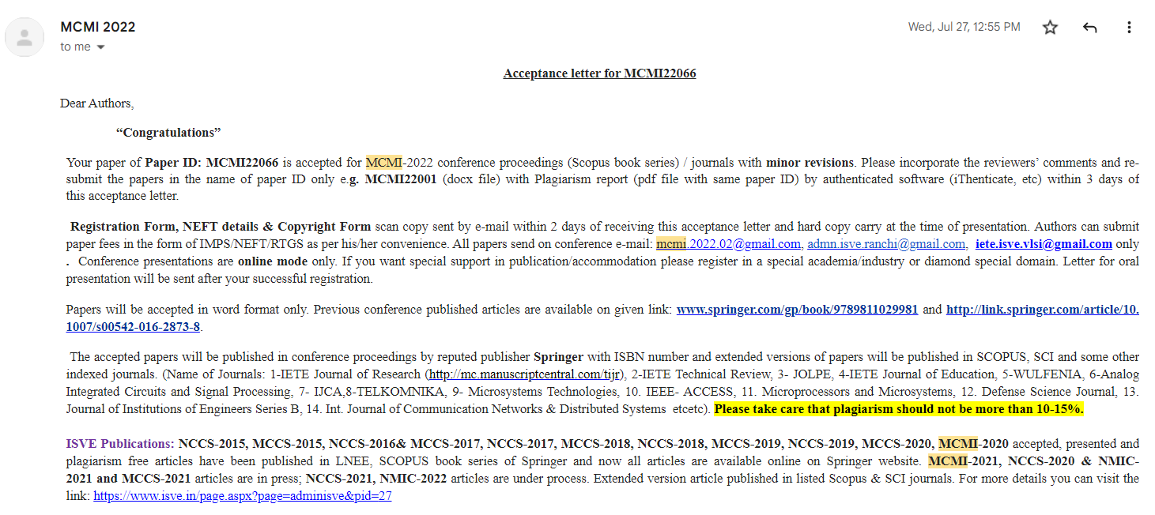
Go, change the world
RV College of
Engineering
Publication
*
Department of ECE
55

Slide 56

Go, change the world
RV College of
Engineering
Thank You
*
Department of ECE
56

